Slide 1
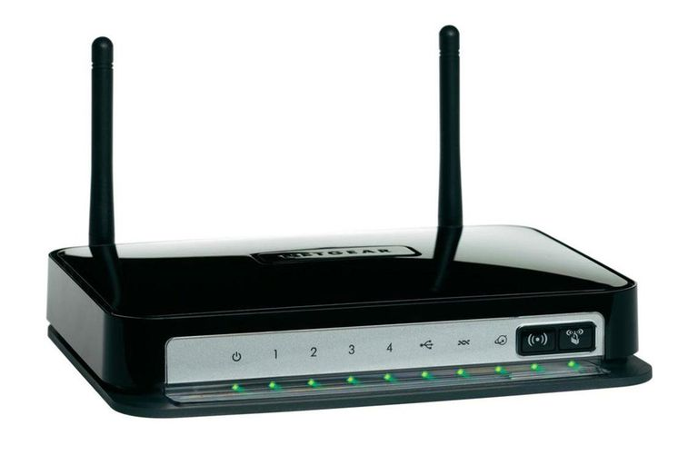
OpenWrt – Part 3
NetGear Wireless-N 300 Modem router DGN2200
Many thanks to Ian Young for providing the Modem
Waikato Linux Users Group
25 February 2019
Ian Stewart

Slide 2
OpenWrt – Part 3
NetGear Wireless-N 300 Modem router DGN2200
Contents of Presentation:
Overview the DGN2200.
Check-out the DGN web-server based setup
Add a console terminal emulator
Add a tftp server
Install OpenWrt firmware
Boot OpenWrt and login via console
Login via web-browser, use GUI.
Login via Secure Shell (SSH)
Uplink to another Router for internet connection
Packages Update
Add / Remove python3 modules

Slide 3
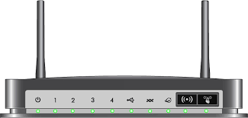
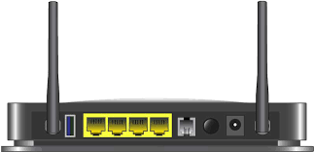
NetGear Wireless-N 300 Modem router DGN2200
Features.
Administration Settings:
http://www.routerlogin.net
192.168.0.1
User name: admin
Password: password
Ports:
4 x RJ45 10/100 Mb/s ethernet
1 x USB
1 x RJ11 ADSL
1 x Wifi
Console:
PCB has TTL console pin-out.

Slide 4
NetGear Wireless-N 300 Modem router DGN2200
Connections provided by Netgear firmware:
Plug in a PC via ethernet cable and DGN2200 supplies a DHCP address. E.g. 192.168.0.2
PC web-browser connecting to the http server in the DGN2200.
Enter into PC’s web-browser http://routerlogin.net to access the GUI administration. Translates as 192.168.0.1
SSH:
? - Not permitted

Slide 5
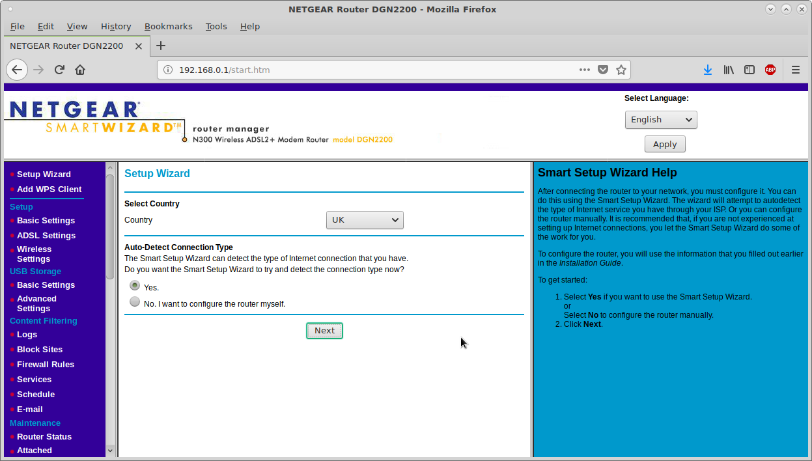
NetGear Wireless-N 300 Modem router DGN2200
Screenshots of the web-based administration.

Slide 6
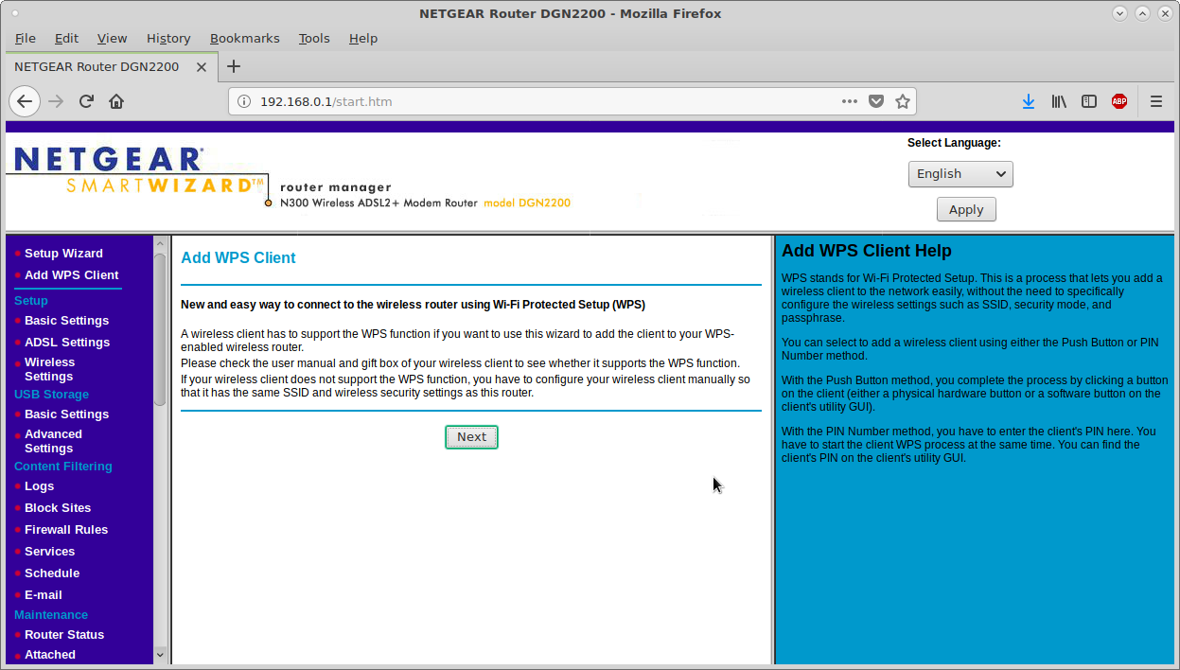
NetGear Wireless-N 300 Modem router DGN2200
Screenshots 2/7

Slide 7
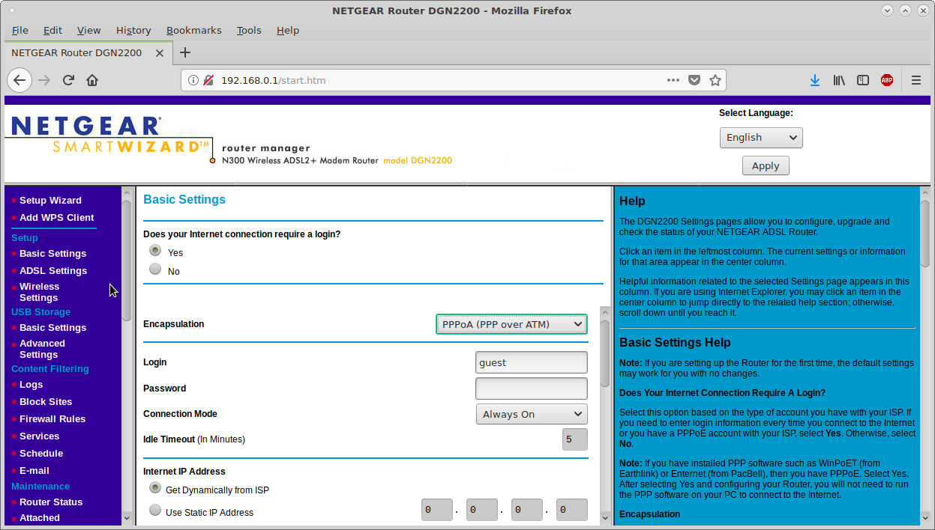
NetGear Wireless-N 300 Modem router DGN2200
Screenshots 3/7

Slide 8
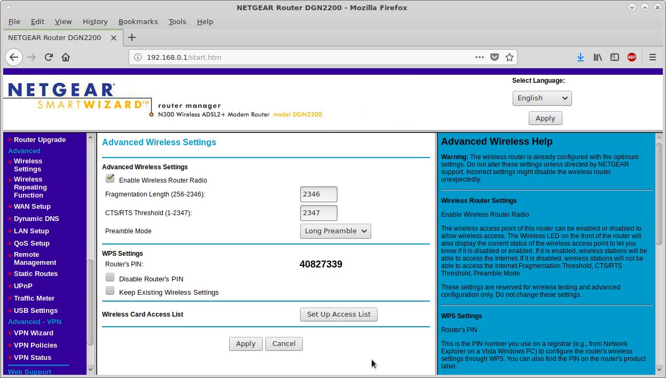
NetGear Wireless-N 300 Modem router DGN2200
Screenshots 4/7

Slide 9
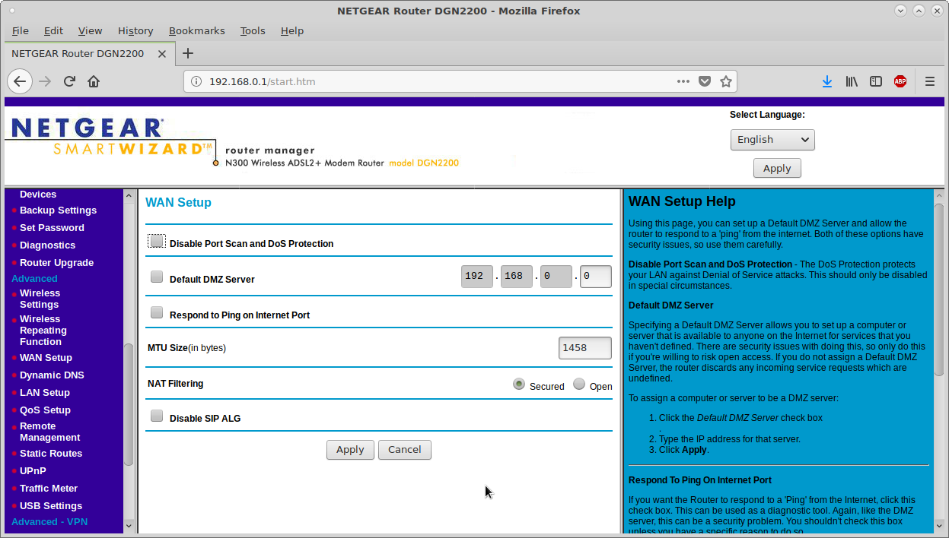
NetGear Wireless-N 300 Modem router DGN2200
Screenshots 5/7

Slide 10
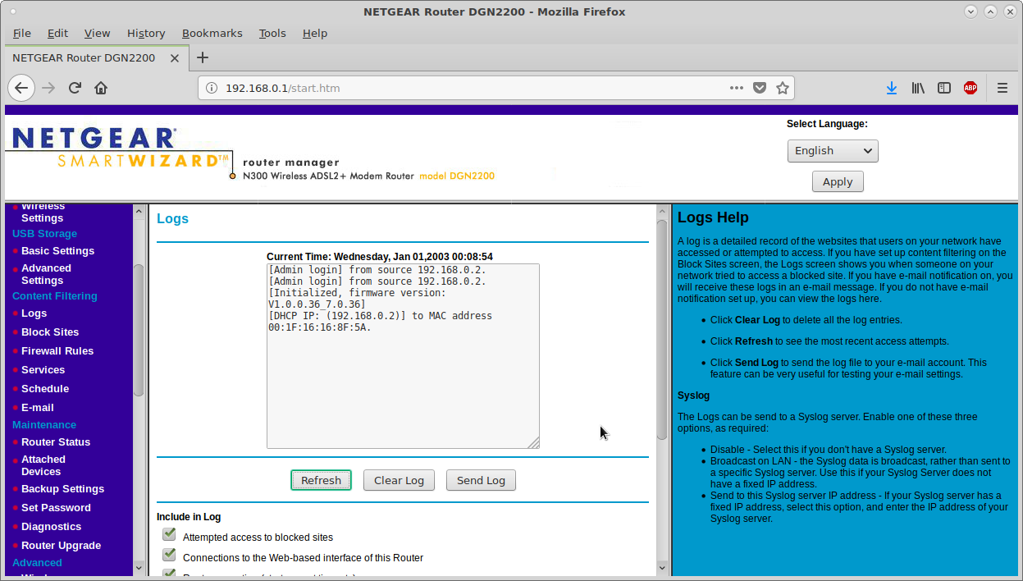
NetGear Wireless-N 300 Modem router DGN2200
Screenshots 6/7

Slide 11
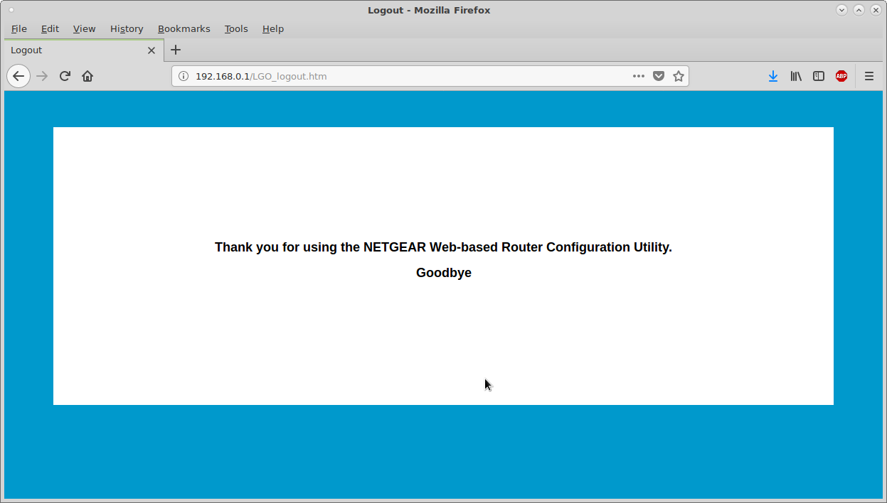
NetGear Wireless-N 300 Modem router DGN2200
Farewell to Netgear firmware

Slide 12
NetGear Wireless-N 300 Modem router DGN2200
OpenWrt Information page for DGN2200
https://openwrt.org/toh/netgear/dgn2200
Highlights:
SoC: BCM6358U
Instruction set: MIPS
Switch: BCM5325
Wireless: BCM43222 (Proprietary drivers)
RAM size: 32 MiB
Flash size: 8192 KiB
Download location for OpenWrt firmware image...
http://downloads.openwrt.org/releases/18.06.2/targets/brcm63xx/smp/openwrt-18.06.2-brcm63xx-smp-96358VW-generic-squashfs-cfe.bin

Slide 13
NetGear Wireless-N 300 Modem router DGN2200
How to install the OpenWrt firmware.
Serial Console
Add TTL console pin-out and to PCB.
Convert the TTL, to RS232, to a USB serial port.
Install PuTTY application on your PC to be the console terminal emulator.
You can now watch Netgear firmware boot and log into its version of Linux.
Ethernet connection
Connect an ethernet cable from your PC to an RJ45 port on the DGN2200.
Install a Trivial File Transfer Protocol Server application on the PC. (TFTP)
Set PC / TFTP server to 192.168.1.100.
Place OpenWrt firmware in TFTP server folder.

Slide 14

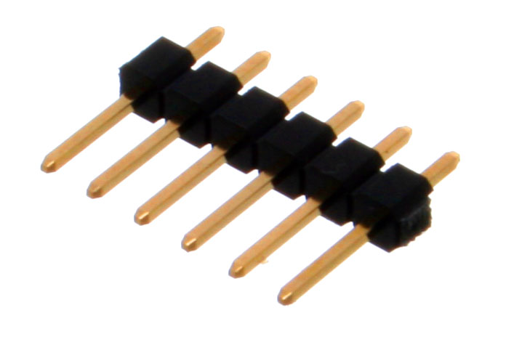
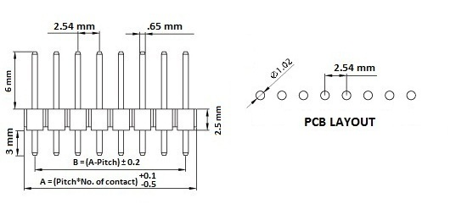
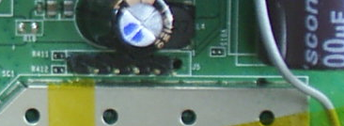
NetGear Wireless-N 300 Modem router DGN2200
Adding the Serial Console.
Tools:
Soldering Iron
Solder sucker
Drill bit 1mm
Extras:
Berg pins x 6
>>> math.sqrt(0.65**2 + 0.65**2)
0.9192388155425119
Pins added for serial TTL console port
Suggestion: 0.5mm drill, wire up Tx, Rx, Gnd to 3.5mm RTS socket.

Slide 15
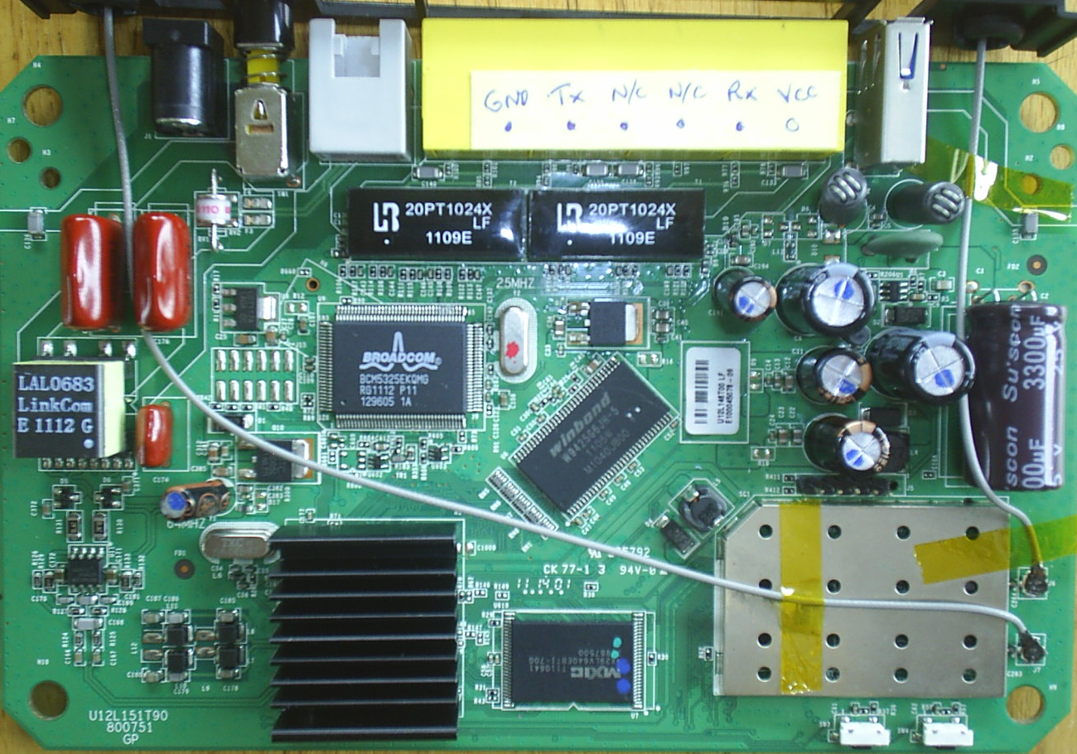
NetGear Wireless-N 300 Modem router DGN2200
Pins added for serial TTL console port

Slide 16
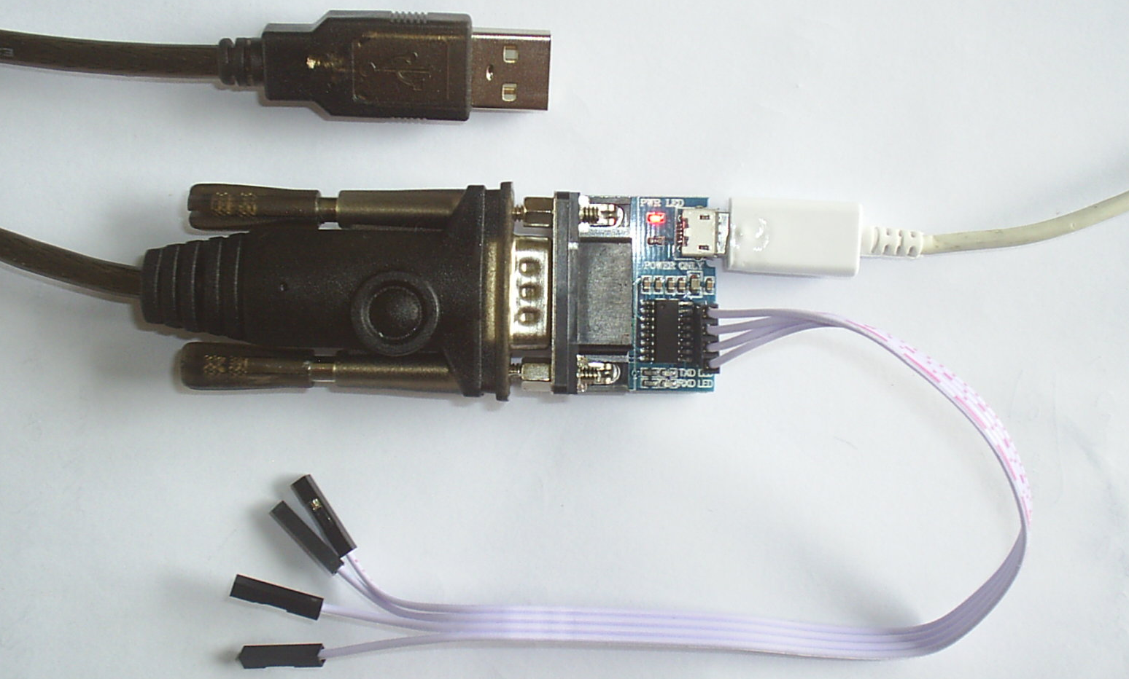
NetGear Wireless-N 300 Modem router DGN2200
Connects to PC as /dev/ttyUSB0
Optional MicroUSB cable supplying power.
USB to Serial RS232 DB9 male
Connects to DGN2200.
Tx, Rx & Gnd. Vcc if not using external MicroUSB
Serial RS232 DB9 female to TTL.

Slide 17
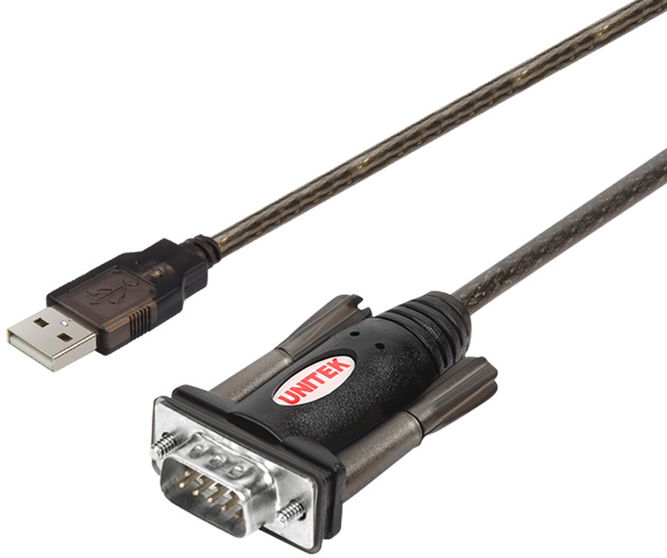
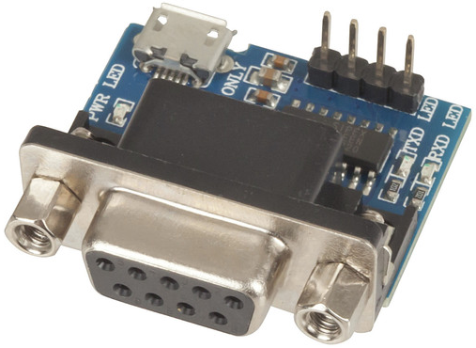
NetGear Wireless-N 300 Modem router DGN2200
USB Type A to DB9 male (RS232) serial port. Device: /dev/ttyUSB0
RS232: 0 (space) Asserted +3 to +15 V
RS232: 1 (mark) Deasserted −15 to −3 V
DB9 female (RS232) to Transistor-Transistor-Logic TTL Tx: 0 to 0.5 = 0 and 2.7 to 5V = 1
TTL Rx: 0 to 0.8 = 0 and 2.0 to 5V = 1
Pins: Tx, Rx, +Vcc, Gnd
MicroUSB: Power if not using +Vcc
USB to RS232 DB9 male: https://www.pbtech.co.nz/product/ADPDNX0810/Unitek-BF-810Y-15M-USB-to-Serial-DB9-RS232-Cable-Y
RS232 DB9 female to TTL Tx, Rx Gnd, Vcc
https://www.jaycar.co.nz/rs-232-to-ttl-uart-converter-module/p/XC3724

Slide 18
NetGear Wireless-N 300 Modem router DGN2200
How to install the OpenWrt firmware.
Power on DGN2200 and press a key to enter into Common Firmware Environment. CFE> prompt.
eth0 needs to have its gateway defined. With the command: CFE> ifconfig eth0 –gw=192.168.1.1
CFE command f to download and flash the image. E.g. CFE> f 192.168.1.100:openwrt_firmware.bin
Firmware downloads...
Firmware written to flash...
DGN2200 reboots and comes up running OpenWrt.

Slide 19
DGN2200 – Installing OpenWrt firmware
PC
RS232 to TTL
o o o
USB
port
uUSB
Pwr +5v
PuTTY
Terminal emulator
serial port on USB0
USB
port
USB to RS232 converter
Netgear
DGN2200
Tftpd32
Trivial File Transfer Protocol server
o o o
Tx Rx Gnd
TTL Console
Common Firmware Environment
CFE> f
OpenWrt
Firmware binary file
RAM 32MB
Flash
8MB
Ethernet
192.168.1.100
Ethernet - eth0 192.168.1.1
USB to RS232 DB9 male: https://www.pbtech.co.nz/product/ADPDNX0810/Unitek-BF-810Y-15M-USB-to-Serial-DB9-RS232-Cable-Y
RS232 DB9 femaie to TTL Tx, Rx Gnd, Vcc
https://www.jaycar.co.nz/rs-232-to-ttl-uart-converter-module/p/XC3724

Slide 20
DGN2200 – Booting Netgear firmware
DGN2200 Boot Code V1.0.6
CFE version 1.0.37-102.9 for BCM96358 (32bit,SP,BE)
Build Date: Fri Nov 6 12:05:36 CST 2009 (weal@svn)
Copyright (C) 2000-2009 Broadcom Corporation.
Parallel flash device: name AM29DL800B, id 0x22cb, size 8192KB
CPU type 0x2A010: 300MHz, Bus: 133MHz, Ref: 64MHz
CPU running TP0
Total memory: 33554432 bytes (32MB)
Boot Address 0xbe000000
Board IP address : 192.168.1.1:ffffff00
Host IP address : 192.168.1.100
Gateway IP address :
Run from flash/host (f/h) : f
Default host run file name : vmlinux
Default host flash file name : bcm963xx_fs_kernel
Boot delay (0-9 seconds) : 1
Board Id (0-5) : 96358VW
Number of MAC Addresses (1-32) : 11
Base MAC Address : a0:21:b7:74:1b:e6
PSI Size (1-64) KBytes : 48
Main Thread Number [0|1] : 0
*** Press any key to stop auto run (1 seconds) ***
Auto run second count down: 111
CFE>
Key pressed on keyboard.
CFE> prompt

Slide 21
DGN2200 – Common Firmware Environment
CFE> help
Available commands:
tftpd Start TFTP server
sm Set memory or registers.
dm Dump memory or registers.
w Write the whole image start from beginning of the flash
e Erase [n]vram or [a]ll flash except bootrom
r Run program from flash image or from host depend on [f/h] flag
p Print boot line and board parameter info
c Change booline parameters
f Write image to the flash
i Erase persistent storage data
b Change board parameters
reset Reset the board
flashimage Flashes a compressed image after the bootloader.
ifconfig Configure the Ethernet interface
help Obtain help for CFE commands
For more information about a command, enter 'help command-name'
*** command status = 0
CFE> ifconfig
Device eth0: hwaddr A0-21-B7-74-1B-E6, ipaddr 192.168.1.1, mask 255.255.255.0
gateway not set, nameserver not set
*** command status = 0
Use f command

Slide 22
DGN2200 – Booting Netgear firmware
CFE> f 192.168.1.100:openwrt-18.06.2-brcm63xx-smp-96358VW-generic-squashfs-cfe.bin
Loading 192.168.1.100:openwrt-18.06.2-brcm63xx-smp-96358VW-generic-squashfs-cfe.bin ...
Loading failed.: CFE error -21
*** command status = -21
CFE> ifconfig eth0 -gw=192.168.1.1
Device eth0: hwaddr A0-21-B7-74-1B-E6, ipaddr 192.168.1.1, mask 255.255.255.0
gateway 192.168.1.1, nameserver not set
*** command status = 0
CFE> f 192.168.1.100:openwrt-18.06.2-brcm63xx-smp-96358VW-generic-squashfs-cfe.bin
Loading 192.168.1.100:openwrt-18.06.2-brcm63xx-smp-96358VW-generic-squashfs-cfe.bin ...
Finished loading 3211268 bytes
Flashing root file system and kernel at 0xbe010000: ..................................................
.
*** Image flash done *** !
Resetting board...

Slide 23
DGN2200 – Booting Netgear/Broadcom CFE
Resetting board...
GN2200 Boot Code V1.0.6
CFE version 1.0.37-102.9 for BCM96358 (32bit,SP,BE)
Build Date: Fri Nov 6 12:05:36 CST 2009 (weal@svn)
Copyright (C) 2000-2009 Broadcom Corporation.
Parallel flash device: name AM29DL800B, id 0x22cb, size 8192KB
CPU type 0x2A010: 300MHz, Bus: 133MHz, Ref: 64MHz
CPU running TP0
Total memory: 33554432 bytes (32MB)
Boot Address 0xbe000000
Board IP address : 192.168.1.1:ffffff00
Host IP address : 192.168.1.100
Gateway IP address :
Run from flash/host (f/h) : f
Default host run file name : vmlinux
Default host flash file name : bcm963xx_fs_kernel
Boot delay (0-9 seconds) : 1
Board Id (0-5) : 96358VW
Number of MAC Addresses (1-32) : 11
Base MAC Address : a0:21:b7:74:1b:e6
PSI Size (1-64) KBytes : 48
Main Thread Number [0|1] : 0

Slide 24
DGN2200 – Booting OpenWrt Linux 4.9.152
Do not press keyboard key.
Continues to boot
*** Press any key to stop auto run (1 seconds) ***
Auto run second count down: 110
Booting from only image (0xbe010000) ...
Code Address: 0x80A00000, Entry Address: 0x80a00000
LZMA: Prossible old LZMA format, trying to decompress..
Decompression OK!
Entry at 0x80a00000
Closing network.
Closing DMA Channels.
Starting program at 0x80a00000
[ 0.000000] Linux version 4.9.152 (buildbot@7befac494a11) (gcc version 7.3.0 (OpenWrt GCC 7.3.0 r7676-cddd7b4c77) ) #0 SMP Wed Jan 30 12:21:02 2019
[ 0.000000] Detected Broadcom 0x6358 CPU revision a1
[ 0.000000] CPU frequency is 300 MHz
[ 0.000000] 32MB of RAM installed
[ 0.000000] board_bcm963xx: Boot address 0xbe000000
[ 0.000000] board_bcm963xx: CFE version: 1.0.37-102.9
[ 0.000000] bootconsole [early0] enabled
[ 0.000000] CPU0 revision is: 0002a010 (Broadcom BMIPS4350)
[ 0.000000] board: board name: 96358VW
[ 0.000000] MIPS: machine is Broadcom BCM96358VW reference board
[ 0.000000] Determined physical RAM map:
[ 0.000000] memory: 02000000 @ 00000000 (usable)
[ 0.000000] Initrd not found or empty - disabling initrd
[ 0.000000] Primary instruction cache 32kB, VIPT, 2-way, linesize 16 bytes.
[ 0.000000] Primary data cache 16kB, 2-way, VIPT, cache aliases, linesize 16 bytes

Slide 25
DGN2200 – Booted OpenWrt 18.06.2
[ 42.780495] jffs2_build_filesystem(): erasing all blocks after the end marker...
[ 53.424307] random: crng init done
[ 53.427782] random: 2 urandom warning(s) missed due to ratelimiting
BusyBox v1.28.4 () built-in shell (ash)
_______ ________ __
| |.-----.-----.-----.| | | |.----.| |_
| - || _ | -__| || | | || _|| _|
|_______|| __|_____|__|__||________||__| |____|
|__| W I R E L E S S F R E E D O M
-----------------------------------------------------
OpenWrt 18.06.2, r7676-cddd7b4c77
-----------------------------------------------------
=== WARNING! ===========
There is no root password defined on this device!
Use the "passwd" command to set up a new password
in order to prevent unauthorized SSH logins.
--------------------------------------------------
root@OpenWrt:/#
Booting has finished.
Pressed Enter key
/#
At top of the tree

Slide 26
DGN2200 – OpenWrt 1/2
root@OpenWrt:/# & <tab> <tab>
[ grep mkswap sleep
[[ gunzip mktemp sort
ash gzip modinfo ssh
askfirst halt modprobe start-stop-daemon
awk head mount strings
basename hexdump mount_root swconfig
board_detect hotplug-call mtd switch_root
brctl hwclock mv sync
bunzip2 id nc sysctl
busybox ifconfig netifd sysupgrade
bzcat ifdown netmsg tail
cat ifstatus netstat tar
chgrp ifup nice tee
chmod init nslookup test
chown insmod ntpd time
chroot ip ntpd-hotplug top
clear ip6tables odhcp6c touch
cmp ip6tables-restore odhcpd tr
config_generate ip6tables-save odhcpd-update traceroute
cp ipcalc.sh opkg traceroute6
crond iptables opkg-key true
crontab iptables-restore passwd ubus
cut iptables-save pgrep ubusd
...continues on next slide...

Slide 27
DGN2200 – OpenWrt 2/2
date jffs2mark pidof uci
dbclient jffs2reset ping uclient-fetch
dd jshn ping6 udevtrigger
devstatus jsonfilter pivot_root udhcpc
df kill poweroff uhttpd
dirname killall pppd umount
dmesg kmodloader printf uname
dnsmasq ldd procd uniq
dropbear led.sh ps upgraded
dropbearkey less pwd uptime
du ln readlink urandom_seed
echo lock reboot usign
egrep logd reload_config validate_data
env logger reset vi
expr login rm wc
false logread rmdir wget
fgrep ls rmmod which
find lsmod route wifi
firstboot lua rpcd xargs
flock luci-bwc scp xtables-multi
free luci-reload sed yes
fsync md5sum seq zcat
fw3 mkdir sh
fwtool mkfifo sha256sum
getrandom mknod signify

Slide 28
DGN2200 - OpenWrt directory structure
root@OpenWrt:/# ls
bin etc mnt proc root sys usr www
dev lib overlay rom sbin tmp var

Slide 29
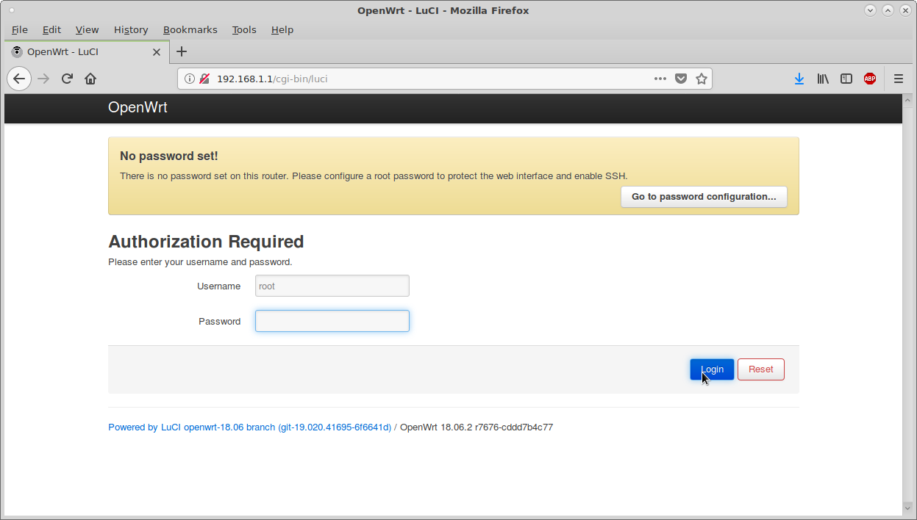
DGN2200 – GUI web-based administration
Connect via ethernet address: 192.168.1.1

Slide 30
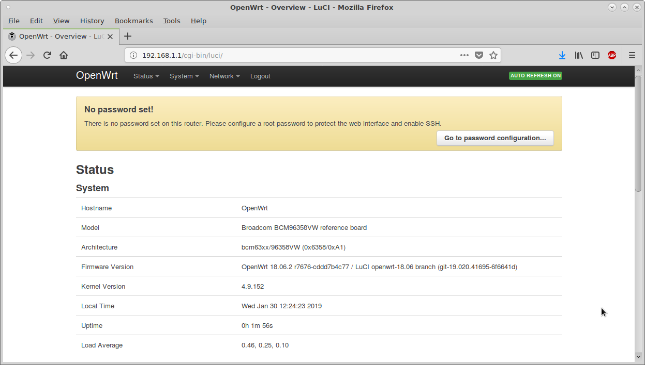
DGN2200 – GUI web-based administration

Slide 31
DGN2200 – SSH
ian@X200:~$ ssh 192.168.1.1
@@@@@@@@@@@@@@@@@@@@@@@@@@@@@@@@@@@@@@@@@@@@@@@@@@@@@@@@@@@
@ WARNING: REMOTE HOST IDENTIFICATION HAS CHANGED! @
@@@@@@@@@@@@@@@@@@@@@@@@@@@@@@@@@@@@@@@@@@@@@@@@@@@@@@@@@@@
IT IS POSSIBLE THAT SOMEONE IS DOING SOMETHING NASTY!
Someone could be eavesdropping on you right now (man-in-the-middle attack)!
It is also possible that a host key has just been changed.
The fingerprint for the RSA key sent by the remote host is
SHA256:JOdX4tbN5/ttneNFo4/qSoXhQ4qSSBgAmHaSLYfb1js.
Please contact your system administrator.
Add correct host key in /home/ian/.ssh/known_hosts to get rid of this message.
Offending RSA key in /home/ian/.ssh/known_hosts:1
remove with:
ssh-keygen -f "/home/ian/.ssh/known_hosts" -R 192.168.1.1
RSA host key for 192.168.1.1 has changed and you have requested strict checking.
Host key verification failed.
ian@X200:~$ ssh-keygen -f "/home/ian/.ssh/known_hosts" -R 192.168.1.1
# Host 192.168.1.1 found: line 1
/home/ian/.ssh/known_hosts updated.
Original contents retained as /home/ian/.ssh/known_hosts.old
ian@X200:~$ ssh 192.168.1.1
The authenticity of host '192.168.1.1 (192.168.1.1)' can't be established.
RSA key fingerprint is SHA256:JOdX4tbN5/ttneNFo4/qSoXhQ4qSSBgAmHaSLYfb1js.
Are you sure you want to continue connecting (yes/no)? yes
Warning: Permanently added '192.168.1.1' (RSA) to the list of known hosts.
ian@192.168.1.1's password:

Slide 32
DGN2200 – SSH account root
Permission denied, please try again.
ian@192.168.1.1's password:
Permission denied, please try again.
ian@192.168.1.1's password:
Authentication failed.
ian@X200:~$
ian@X200:~$ ssh root@192.168.1.1
BusyBox v1.28.4 () built-in shell (ash)
_______ ________ __
| |.-----.-----.-----.| | | |.----.| |_
| - || _ | -__| || | | || _|| _|
|_______|| __|_____|__|__||________||__| |____|
|__| W I R E L E S S F R E E D O M
-----------------------------------------------------
OpenWrt 18.06.2, r7676-cddd7b4c77
-----------------------------------------------------
=== WARNING! =====================================
There is no root password defined on this device!
Use the "passwd" command to set up a new password
in order to prevent unauthorized SSH logins.
--------------------------------------------------
root@OpenWrt:~#

Slide 33
DGN2200 – OpenWrt Functionality
Default action
Any ethernet port will act as an uplink to another router.
That port will be dhcp server by the other router and given an IP address. E.g 10.1.1.10
PC’s plugged into other ports will be served by the other router DHCP addresses.
No longer able to connect in via 192.168.1.1 using browser of ssh
i.e. Unable to manage via ssh
Try setting to 10.1.1.200 and see if I can connect when already assigned to a 10.1.1.x address
Set gateway to 10.1.1.1 and DNS to 8.8.8.8
Installed Python. Used up most of the free memory.

Slide 34
DGN2200 – OpenWrt functionality
Copper Wire
Network - ISP
Existing Modem
ADSL
port
WAN Router
Netgear DGN2200
WAN Router
ADSL
port
10.1.1.1
Wifi
10.1.1.200
PC 0
10.1.1.xx
Wifi
Ethernet port
USB
port
Ethernet port
Ethernet - uplink
Ethernet port
Ethernet port
RJ11
Phone
Ethernet port
Ethernet port
Ethernet port
Analogue
Phone
PC 0
10.1.1.xx
PC 1
10.1.1.yy
PC 2
10.1.1.zz

Slide 35
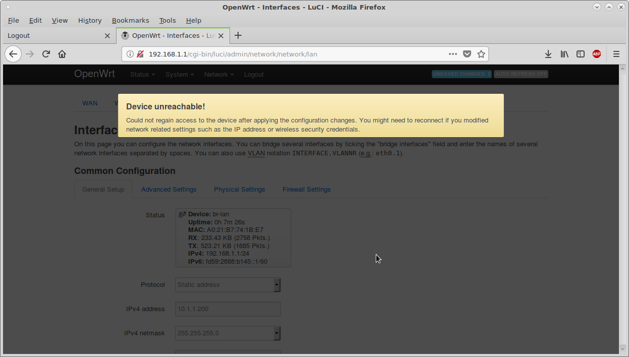
DGN2200 – Up-link to 10.1.1.1 router
Setting DGN2200 from 192.168.1.1 to 10.1.1.200
Was: 192.168.1.1
Change to: 10.1.1.200
Up-link router is 10.1.1.1

Slide 36
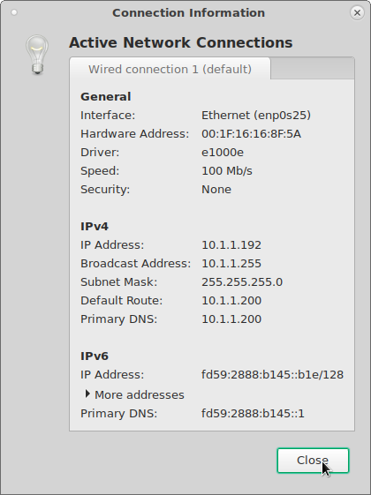
PC – Access to DNG2200 administration
DHCP served by up-link router 10.1.1.192
Have access to internet.
Enter 10.1.1.200 in browser and can connect to DNG2200 for administration.

Slide 37
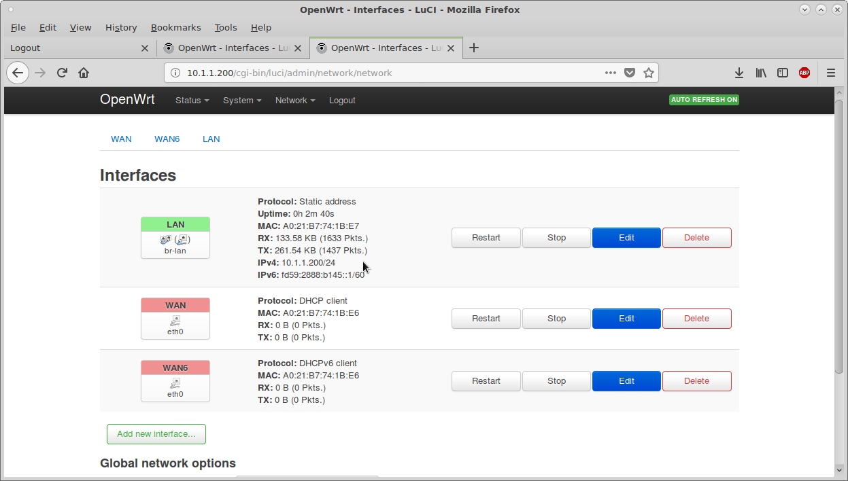
DGN2200 – GUI Access to administration
View Interfaces, etc.

Slide 38
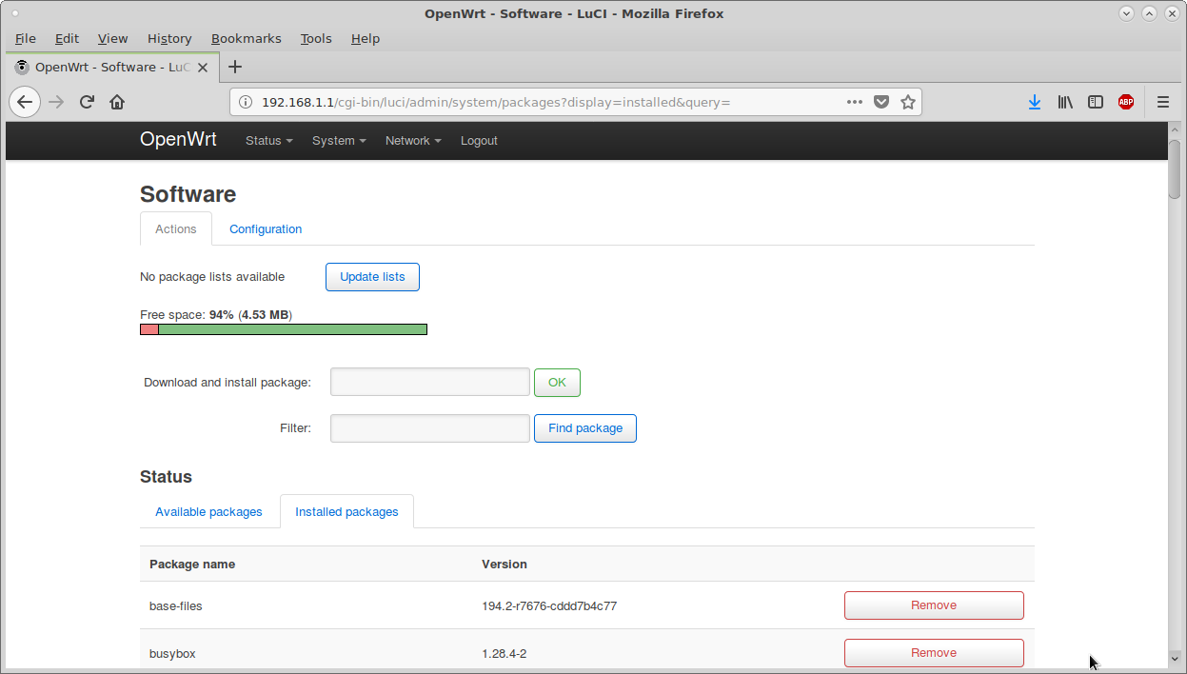
DGN2200 – GUI Access to administration
Flash Memory available for additional software
Packages Installed...

Slide 39
DGN2200 – SSH Access to administration
SSH root@10.1.1.200
ian@X200:~$ ssh root@10.1.1.200
The authenticity of host '10.1.1.200 (10.1.1.200)' can't be established.
RSA key fingerprint is SHA256:JOdX4tbN5/ttneNFo4/qSoXhQ4qSSBgAmHaSLYfb1js.
Are you sure you want to continue connecting (yes/no)? yes
Warning: Permanently added '10.1.1.200' (RSA) to the list of known hosts.
root@10.1.1.200's password:
BusyBox v1.28.4 () built-in shell (ash)
_______ ________ __
| |.-----.-----.-----.| | | |.----.| |_
| - || _ | -__| || | | || _|| _|
|_______|| __|_____|__|__||________||__| |____|
|__| W I R E L E S S F R E E D O M
-----------------------------------------------------
OpenWrt 18.06.2, r7676-cddd7b4c77
-----------------------------------------------------
root@OpenWrt:~#

Slide 40
DGN2200 – Access to administration
SSH
root@OpenWrt:~# pwd
/root
root@OpenWrt:~# cd ..
root@OpenWrt:/# ls
bin etc mnt proc root sys usr www
dev lib overlay rom sbin tmp var
root@OpenWrt:/# cat /etc/openwrt_release
DISTRIB_ID='OpenWrt'
DISTRIB_RELEASE='18.06.2'
DISTRIB_REVISION='r7676-cddd7b4c77'
DISTRIB_TARGET='brcm63xx/smp'
DISTRIB_ARCH='mips_mips32'
DISTRIB_DESCRIPTION='OpenWrt 18.06.2 r7676-cddd7b4c77'
DISTRIB_TAINTS=''
root@OpenWrt:/# cat /etc/openwrt_version
r7676-cddd7b4c77

Slide 41
DGN2200 – Access to administration
root@OpenWrt:/# opkg list-installed ~ Total of 80
base-files | kmod-nf-ipt | liblucihttp-lua | luci-theme-bootstrap
busybox | kmod-nf-ipt6 | libnl-tiny | mtd
dnsmasq | kmod-nf-nat | libpthread | netifd
dropbear | kmod-nf-reject | libubox | odhcp6c
firewall | kmod-nf-reject6 | libubus | odhcpd-ipv6only
fstools | kmod-ppp | libubus-lua | openwrt-keyring
fwtool | kmod-pppoe | libuci | opkg
ip6tables | kmod-pppox | libuclient | ppp
iptables | kmod-slhc | libxtables | ppp-mod-pppoe
jshn | libblobmsg-json | logd | procd
jsonfilter | libc | lua | rpcd
kernel | libgcc | luci | rpcd-mod-rrdns
kmod-gpio-button-hotplug | libip4tc | luci-app-firewall | swconfig
kmod-ip6tables | libip6tc | luci-base | ubox
kmod-ipt-conntrack | libiwinfo | luci-lib-ip | ubus
kmod-ipt-core | libiwinfo-lua | luci-lib-jsonc | ubusd
kmod-ipt-nat | libjson-c | luci-lib-nixio | uci
kmod-lib-crc-ccitt | libjson-script | luci-mod-admin-full | uclient-fetch
kmod-nf-conntrack | liblua | luci-proto-ipv6 | uhttpd
kmod-nf-conntrack6 | liblucihttp | luci-proto-ppp | usign

Slide 42
DGN2200 – Adding Packages
OpenWrt web-site for mips architecture compiled packages...
https://downloads.openwrt.org/releases/18.06.2/packages/mips_mips32/

Slide 43
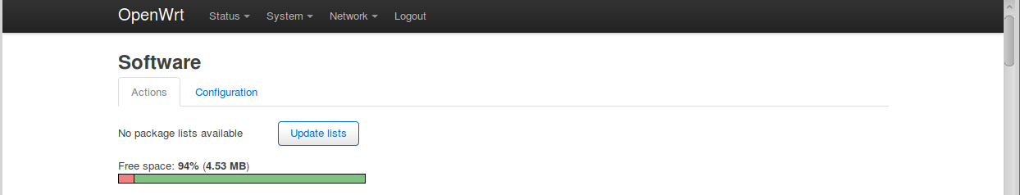
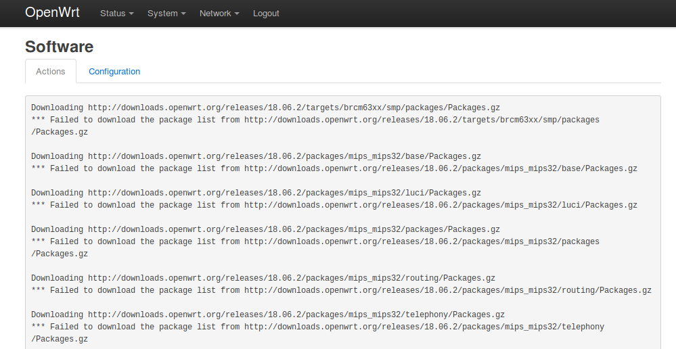
DGN2200 – Adding Packages
Use GUI to Update Package Lists
Fails...

Slide 44
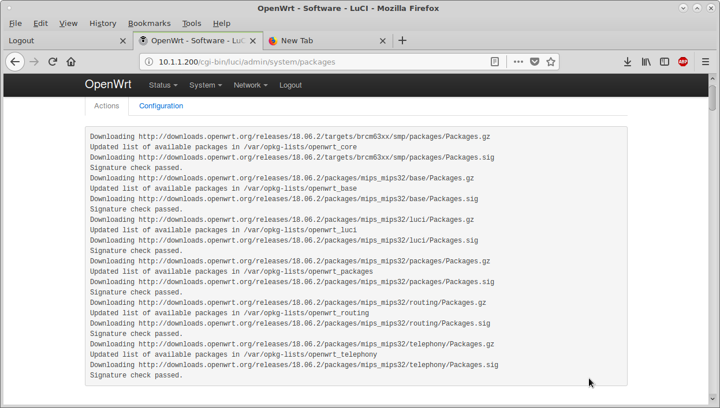
DGN2200 – Adding Packages
Set DGN2200 to have Gateway of 10.1.1.1.
Now able to download the package lists...

Slide 45
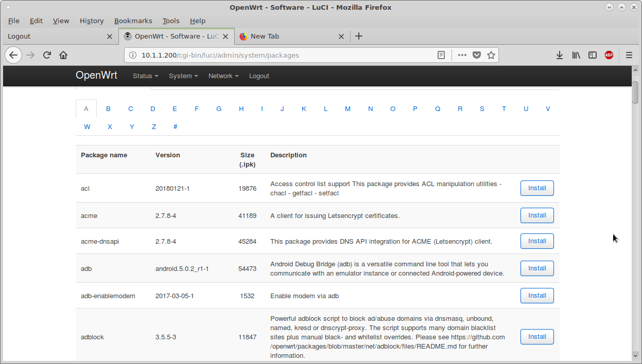
DGN2200 – Adding Packages
List of packages starting with “A”

Slide 46
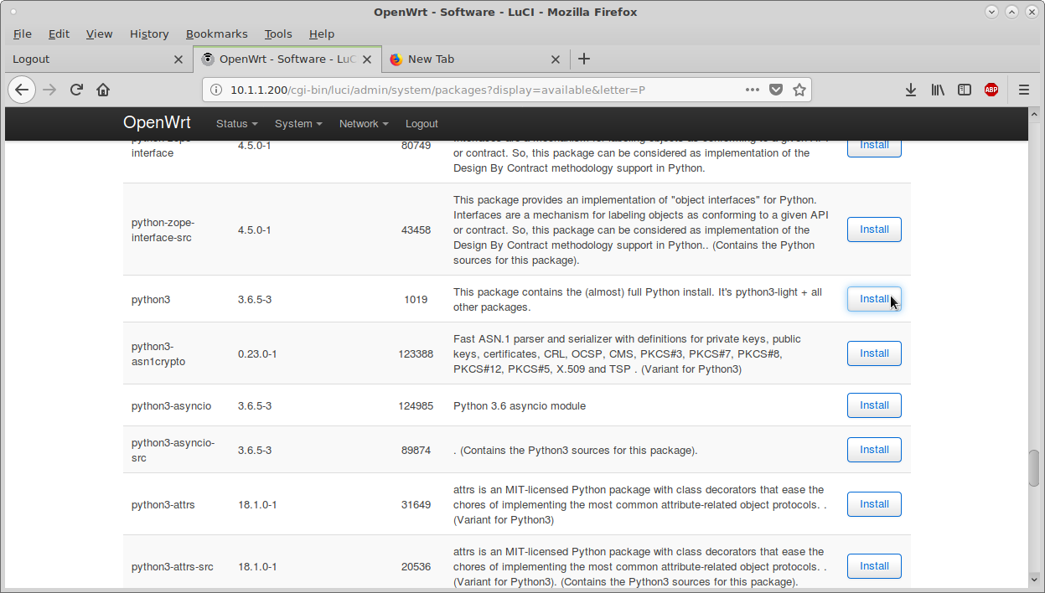
DGN2200 – Adding Packages
Install python3 package

Slide 47
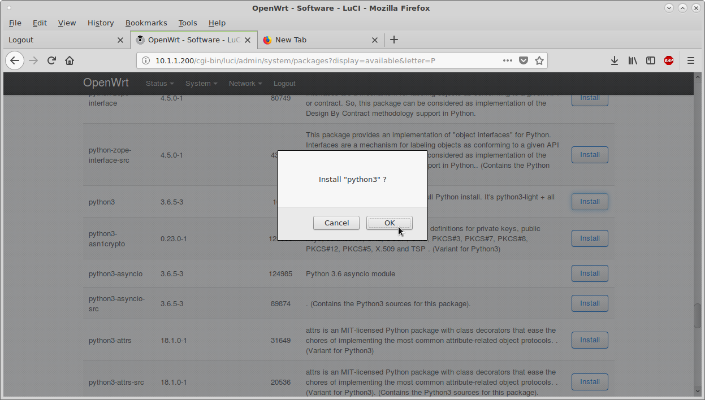
DGN2200 – Adding Packages
Confirm Python3 install

Slide 48
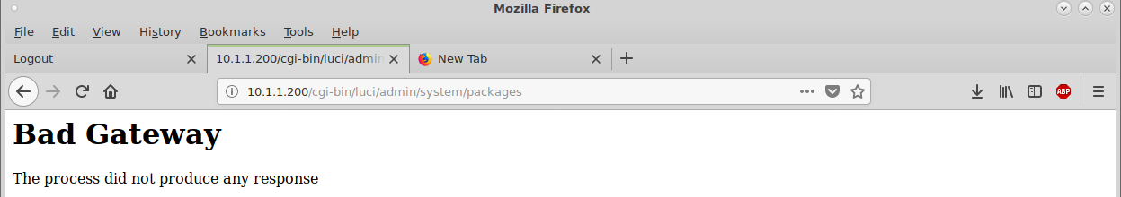

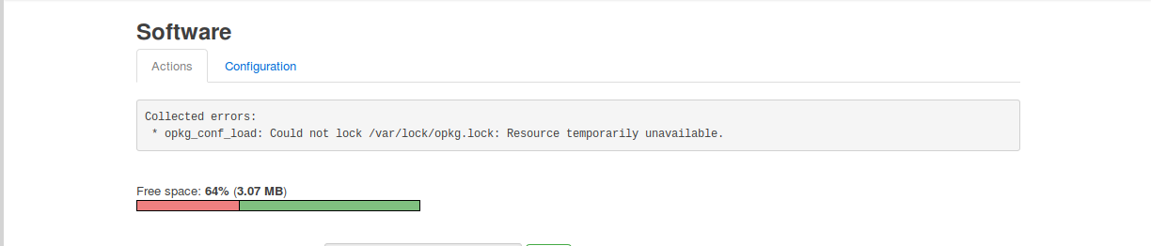
DGN2200 – Adding Packages
Some minor glitches...
More ooops...

Slide 49
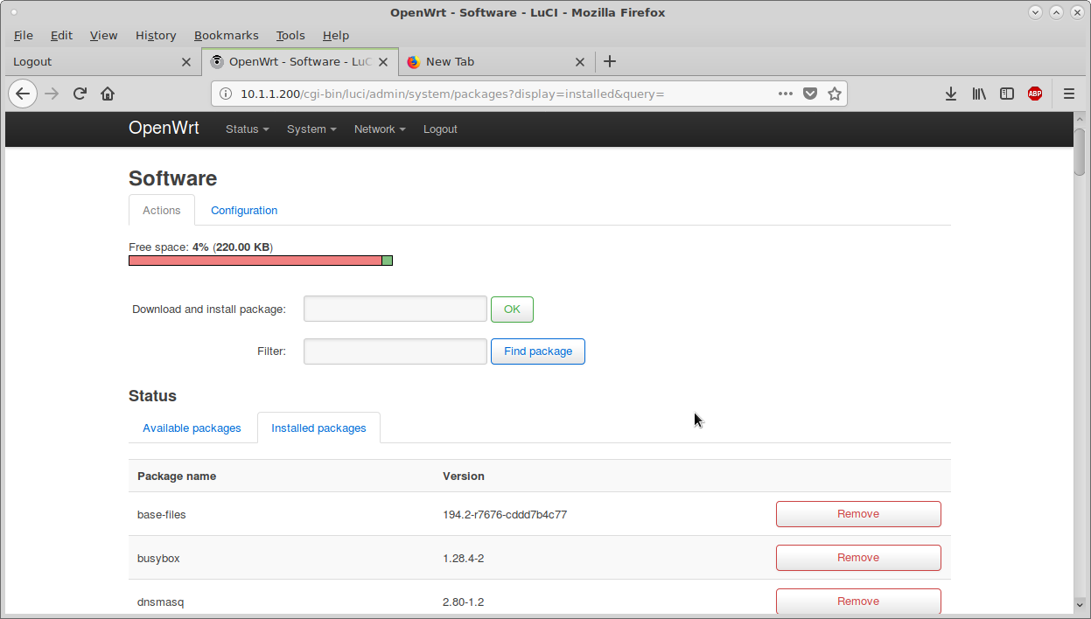
DGN2200 – Adding Packages
Running out of space installing python3...

Slide 50
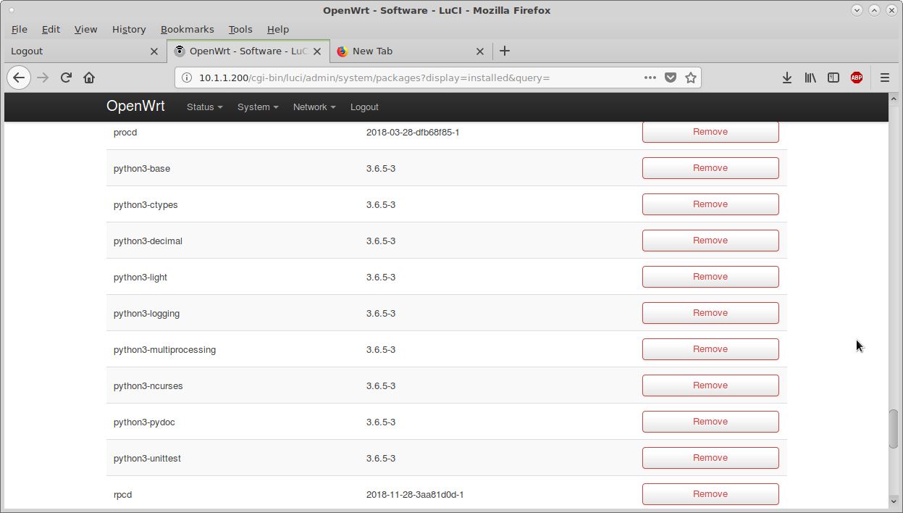
DGN2200 – Adding Packages
9 x Python3 packages now installed...

Slide 51
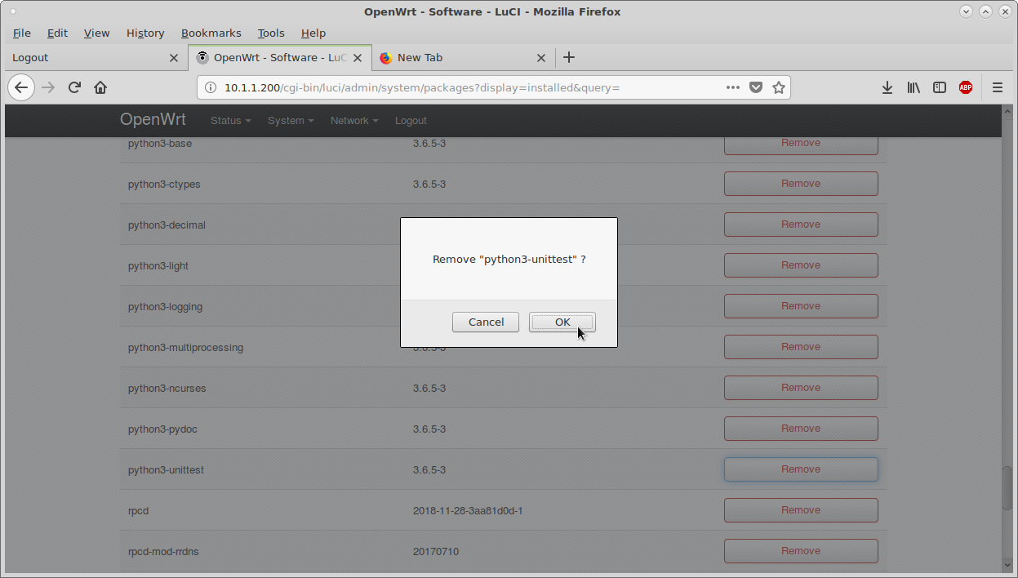
DGN2200 – Remove Packages
Remove some python3 packages...

Slide 52
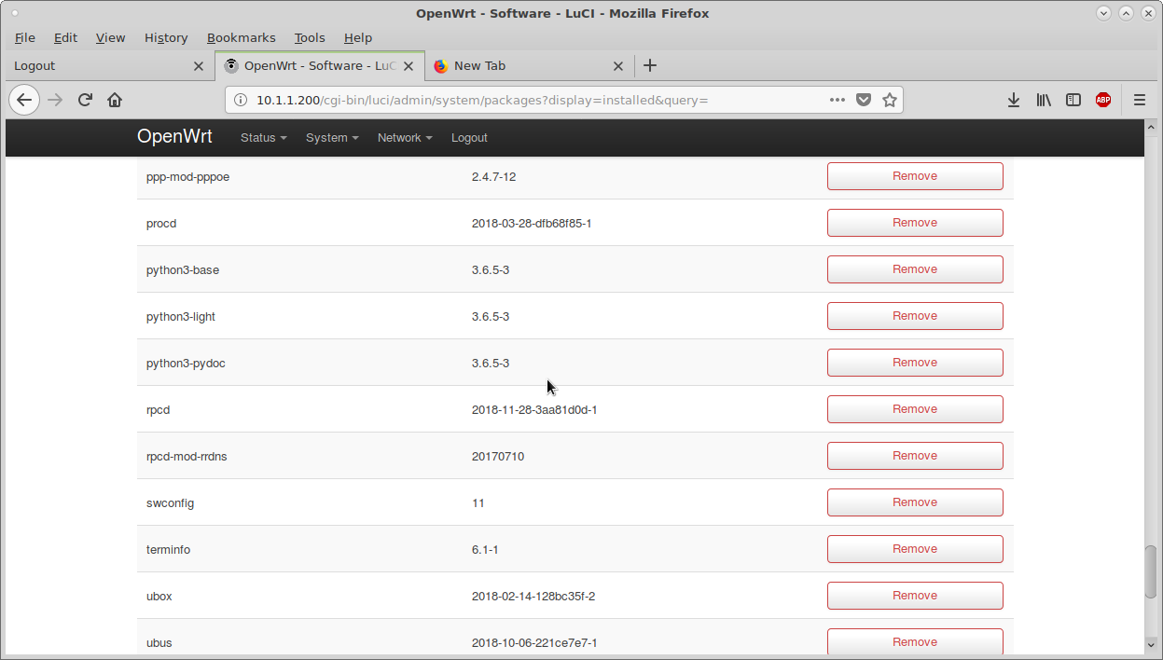
DGN2200 – Packages
Keep 3 x python3 packages. ~50% Free space.

Slide 53
DGN2200 – Adding Packages
Back to SSH to test python3
root@OpenWrt:~# python3
Python 3.6.5 (default, Jan 31 2019, 14:35:22)
[GCC 7.3.0] on linux
Type "help", "copyright", "credits" or "license" for more information.
>>>
>>> help()
Welcome to Python 3.6's help utility!
...

Slide 54
DGN2200 – Adding Packages
SSH: python3 modules (243)
help> modules
Please wait a moment while I gather a list of all available modules...
__future__ atexit inspect shlex
_ast audioop io shutil
_asyncio base64 ipaddress signal
_bisect bdb itertools site
_blake2 binascii json smtpd
_bootlocale binhex keyword smtplib
_bz2 bisect linecache sndhdr
_codecs builtins locale socket
_collections bz2 macpath socketserver
_collections_abc cProfile macurl2path spwd
_compat_pickle calendar mailbox sre_compile
_compression chunk mailcap sre_constants
_crypt cmath marshal sre_parse
_csv cmd math ssl
_datetime code mimetypes stat
_dummy_thread codecs mmap statistics
_functools codeop modulefinder string
_heapq collections netrc stringprep
_imp colorsys nntplib struct
_io compileall ntpath subprocess
_json concurrent nturl2path sunau
_locale configparser numbers symbol

Slide 55
DGN2200 – Adding Packages
SSH python3 modules continued...
_lsprof contextlib opcode symtable
_markupbase copy operator sys
_md5 copyreg optparse sysconfig
_multibytecodec crypt os syslog
_opcode csv ossaudiodev tabnanny
_operator datetime parser tarfile
_pickle difflib pathlib telnetlib
_posixsubprocess dis pdb tempfile
_pydecimal doctest pickle termios
_pyio dummy_threading pickletools textwrap
_random encodings pipes this
_sha1 enum pkgutil threading
_sha256 errno platform time
_sha3 faulthandler plistlib timeit
_sha512 fcntl poplib token
_signal filecmp posix tokenize
_sitebuiltins fileinput posixpath trace
_socket fnmatch pprint traceback
_sre formatter profile tracemalloc
_stat fractions pstats tty
_string ftplib pty turtle
_strptime functools pwd types
_struct gc py_compile typing
_symtable genericpath pyclbr urllib
_sysconfigdata getopt pydoc uu
_thread getpass pydoc_data uuid

Slide 56
DGN2200 – Adding Packages
SSH python3 modules continued...
_threading_local gettext queue venv
_tracemalloc glob quopri warnings
_warnings grp random wave
_weakref gzip re weakref
_weakrefset hashlib reprlib wsgiref
abc heapq resource xdrlib
aifc hmac rlcompleter xxlimited
antigravity html runpy xxsubtype
argparse http sched zipapp
array imaplib secrets zipfile
ast imghdr select zipimport
asynchat imp selectors zlib
asyncore importlib shelve

Slide 57
DGN2200 – Summary
Ideally with OpenWrt / To do on DGN2200...
Functioning OK as a switch.
Install the Broadcom B43 drivers for wifi.
Have one ethernet port dedicated as a WAN.
With WAN then own network addresses.
ADSL if required.
USB port with 3G modem to connect to Internet.
Static IP addresses for printers, etc.
USB drive in USB port for shared storage.
More...?

